Slide 1
Data Binding Exercise
Week 11 1604C062 Advanced Native Mobile Programming
Teknik Informatika
Universitas Surabaya

Slide 2
Binding Adapter
Binding adapters are responsible for making the appropriate framework calls to set values.
The Data Binding Library allows you to specify the method called to set a value, provide your own binding logic, and specify the type of the returned object by using adapters.

Slide 3
Custom Binding Adapter
Some attributes need custom binding logic.
For example, there is no associated setter for the android:paddingLeft attribute.
Instead, the setPadding(left, top, right, bottom) method is provided.

Slide 4
Custom Binding Adapter
BindingAdapter Annotation
To associate custom logic function with custom layout attribute For example here, the paddingLeft attributes will be available to use in the layout
@BindingAdapter("android:paddingLeft")
fun setPaddingLeft(view: View, padding: Int) {
view.setPadding(padding,
view.getPaddingTop(),
view.getPaddingRight(),
view.getPaddingBottom())
}

Slide 5
Custom Binding Adapter
@BindingAdapter("android:paddingLeft")
fun setPaddingLeft(view: View, padding: Int) {
view.setPadding(padding,
view.getPaddingTop(),
view.getPaddingRight(),
view.getPaddingBottom())
}
The Parameter
First parameter always associated with the view object itself.
Second, third and so on are associated with the BindingAdapter custom name

Slide 6
Custom Binding Adapter
@BindingAdapter("imageUrl", "error")
fun loadImage(view: ImageView, url: String, error: Drawable) {
Picasso.get().load(url).error(error).into(view)
}

Slide 7
Exercise
Data Binding
This following exercise use project from Week4

Slide 8
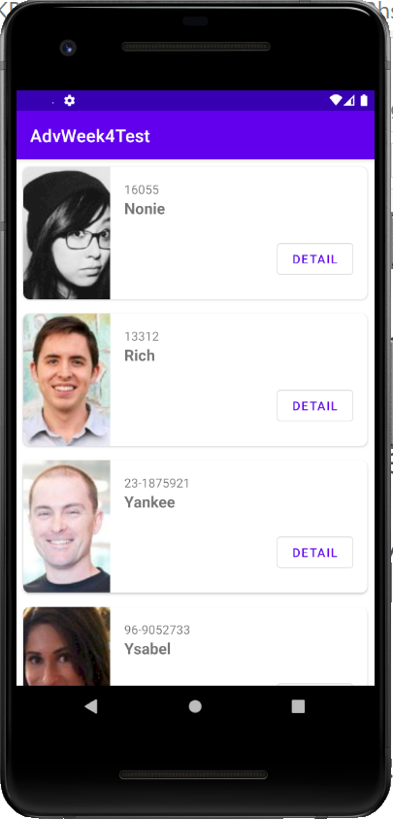
1.
Setting Up
Our goal is to implement data binding on the student list layout

Slide 9
Activate The Binding Features
Open the module gradle
Add following config:
dataBinding {
enabled true
}
Press “sync now” button

Slide 10
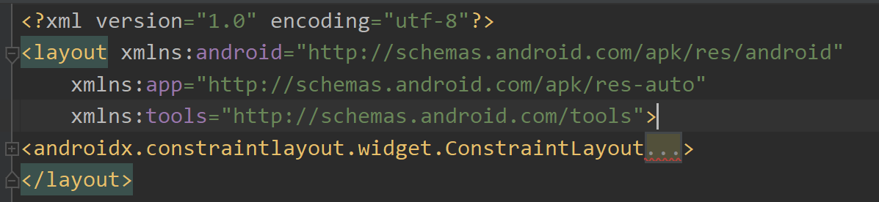
Layout Wrapper
Open the student_list_item.xml
Wrap the original layout with <layout> tag (use the context action)
Don’t forget to rebuild the project

Slide 11
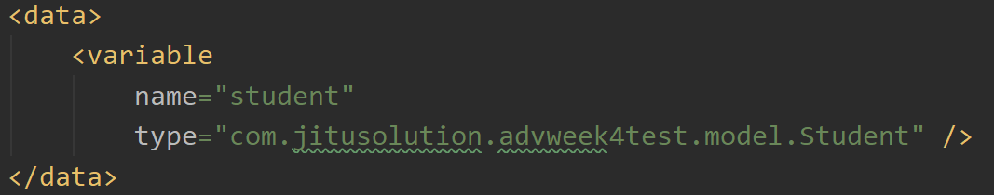
Create Variable
Of course this layout use Student object
Create “student” variable

Slide 12
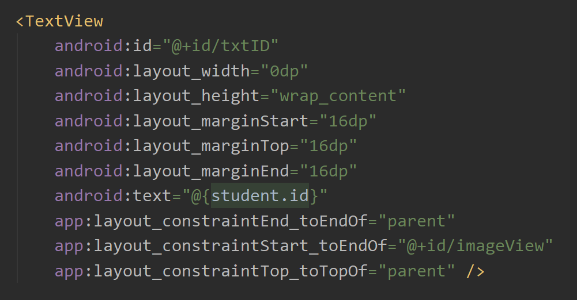
Bind The Variable

Slide 13
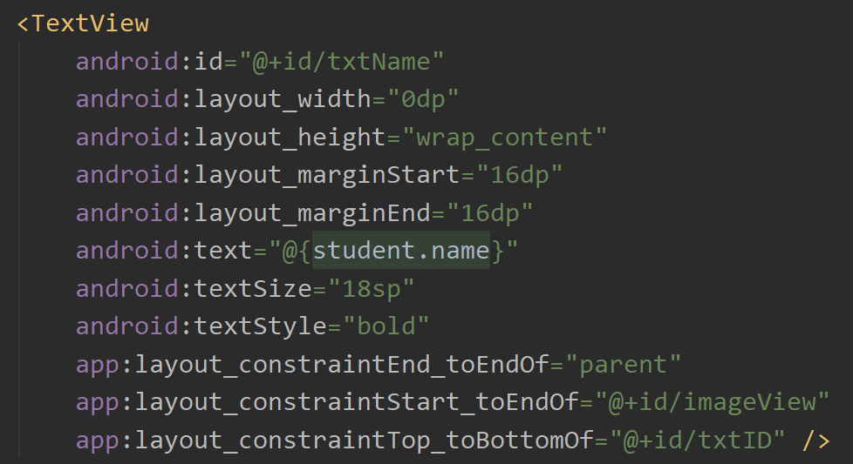
Bind The Variable

Slide 14
Setting Up Adapter to Work With Binding
Rebuild the project
Open the adapter (StudentListAdapter)
Locate the Inner Class StudentViewHolder, change the View type into the Binding Class
Add view.root on its constructor call

Slide 15
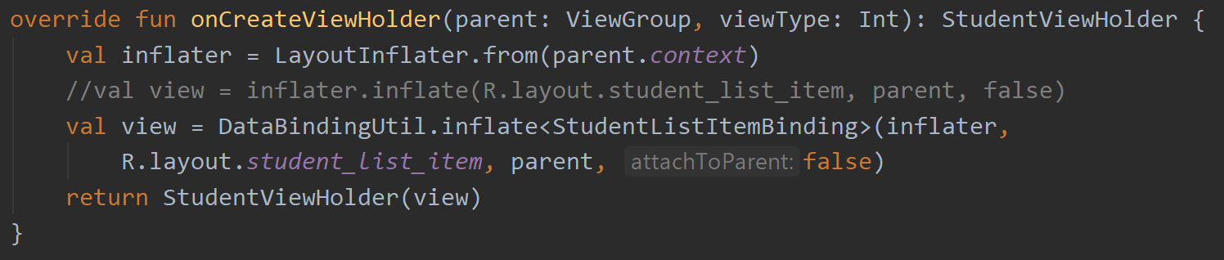
Setting Up Adapter to Work With Binding
Modify onCreateViewHolder

Slide 16
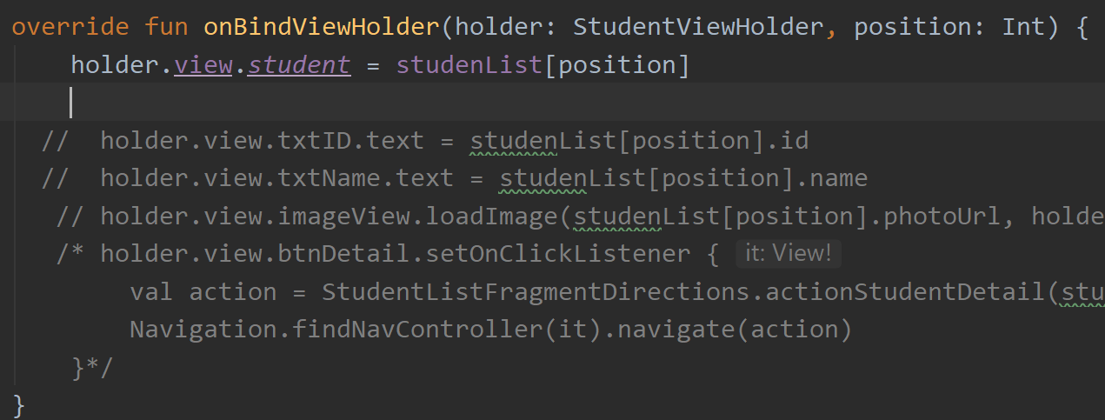
Instantiate The Student Variable
Comment everything in onBindViewHolder body and instantiate the student variable

Slide 17
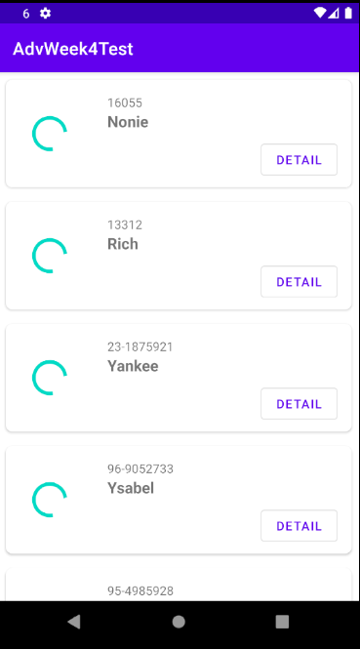
Run The Project
You should see student id and name displayed and already binded with student variable
How about the student photo and detail button?

Slide 18
2.
Listener Binding
Bind the Button Detail

Slide 19
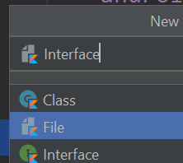
Create Interfaces
Right click on view > new > Kotlin class/file
Name it as Interfaces and set it as “file”

Slide 20
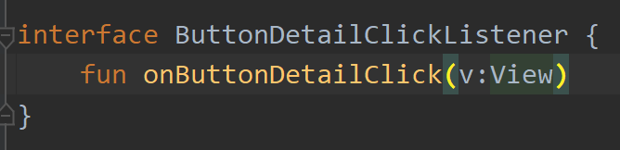
Create Detail Button Click Listener

Slide 21
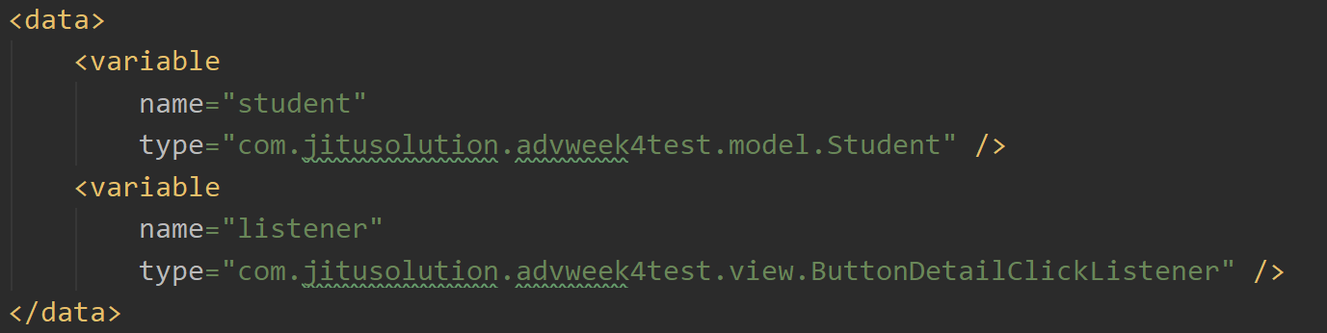
Create Listener Variable
Open the student_list_item.xml
Create listener variable

Slide 22
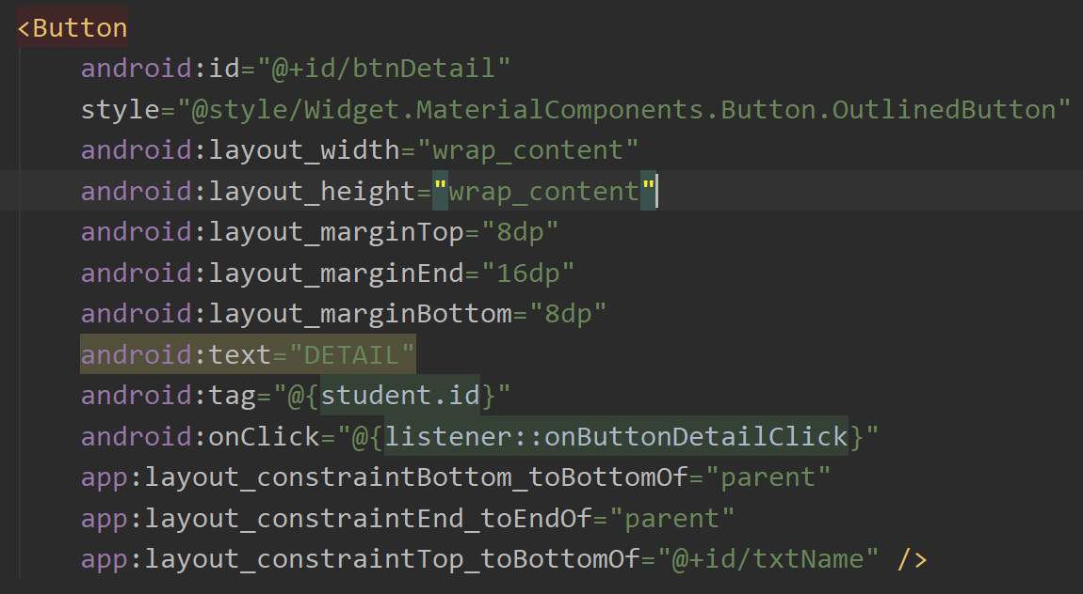
Bind The Listener
Tag Attributes
Tag attributes contain Student ID because it required as part of arguments in navigation

Slide 23
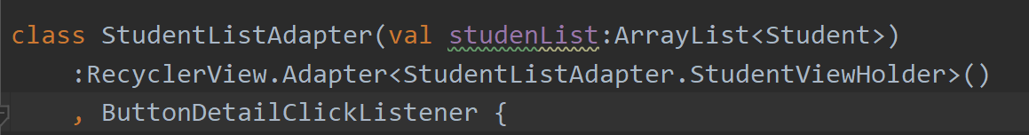
Implement The Listener
Open the Adapter, implement the ButtonDetailClickListener

Slide 24
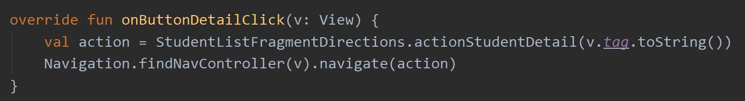
Implement The Listener
Implement the body of ButtonDetailClickListener
Tag Attributes
Student ID accessible through the tag attributes

Slide 25
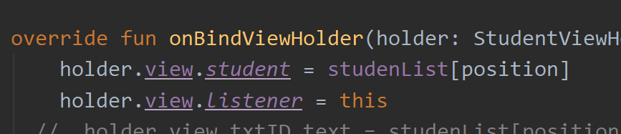
Instantiate The Listener
Check the onBindViewHolder
Instantiate the listener

Slide 26
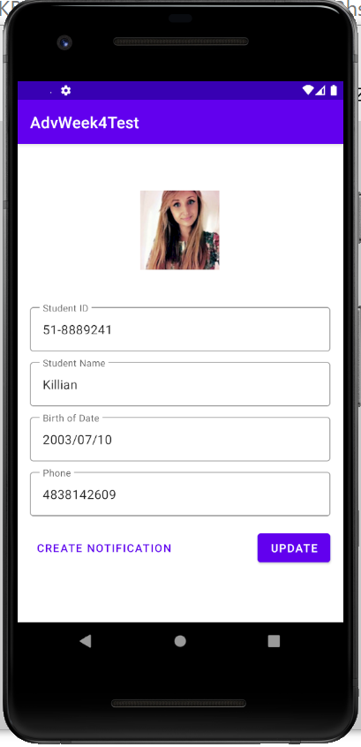
Run The Project
Try to click the detail button. It navigate perfectly.
How about the student photo?

Slide 27
3.
Photo Binding
Using Custom Binding Adapter

Slide 28
Photo Binding
We can’t use listener binding for the image url
We should use attribute binding
However it’s not that simple since the image load is handled by Picasso library
It uses android kotlin extension to extend image view capability with “loadImage” method (see the Util.kt)

Slide 29
Custom Binding Adapter
To solve this, we need to use custom binding adapter and create our custom attribute binding

Slide 30
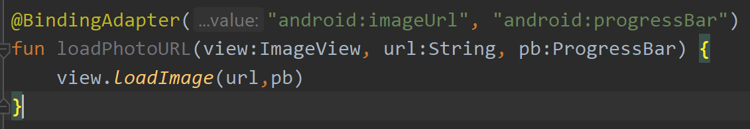
Custom Binding Adapter
loadImage
This binding adapter create two custom attributes: imageUrl, and progressBar
This function simply call android kotlin extension loadImage
Open the Util.kt

Slide 31
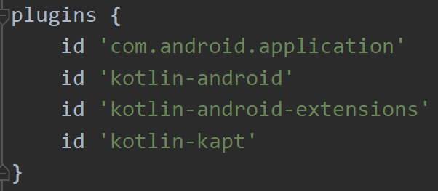
Custom Binding Adapter
Notice an error? Data binding adapter not recognizable?
To solve this, open the module gradle
Add kotlin-kapt in plugins setting
Sync now

Slide 32
Use Custom Binding Adapter
Open the student_list_item.xml
Bind the custom attributes:
imageUrl to student.photoUrl
progressBar to progress bar ID in layout
See next slide

Slide 33
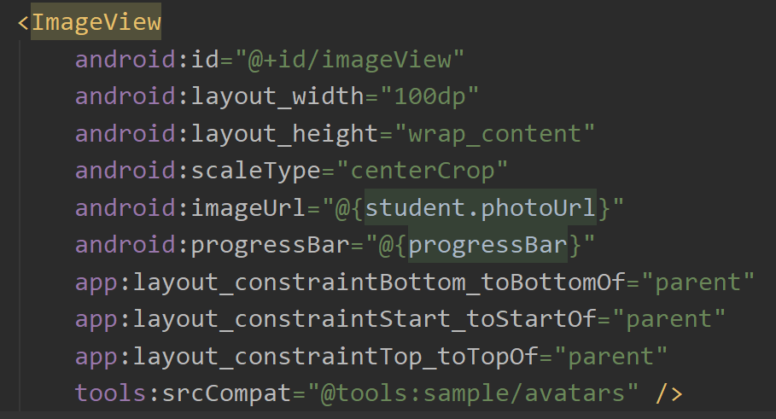

Slide 34
Run The Project
Now everything loads perfectly

Slide 35
HomeWork
Data Binding
Due date week 12

Slide 36
Implement Data Binding on Student Detail
Bind everything you see in the Student Detail page. These include: photo, id, name, bod, phone, the update button, and the notification button

Slide 37
Thanks!
Any questions?
You can find me at
andre@staff.ubaya.ac.id

Slide 38
Credits
Special thanks to all the people who made and released these awesome resources for free:
Presentation template by SlidesCarnival
Photographs by Unsplash

